Slide 1


Materials Science and Nanotechnology
Asst. Prof. Ali J. Mohammed
Lecture Seven
Nanomaterials
Medical Physics Dept. , 2nd stage, 1st semester, 2018-2019

Slide 2

Nanomaterials
* Metals and Alloys
– Fe, Al, Au
* Semiconductors
– Band gap, CdS, TiO₂, ZnO
* Ceramic
– Al₂ O₃, Si₃N₄, MgO, , SiO₂, ZrO₂
* Carbon based
– Diamond, graphite, nanotube, C₆₀
* Polymers
– Soft mater, block co-polymer
* Biological
– Photonic, hydrophobic, adhesive,
* Composites
Medical Physics Dept. , 2nd stage, 1st semester, 2018-2019

Slide 3
Band gap
Medical Physics Dept. , 2nd stage, 1st semester, 2018-2019

Slide 4
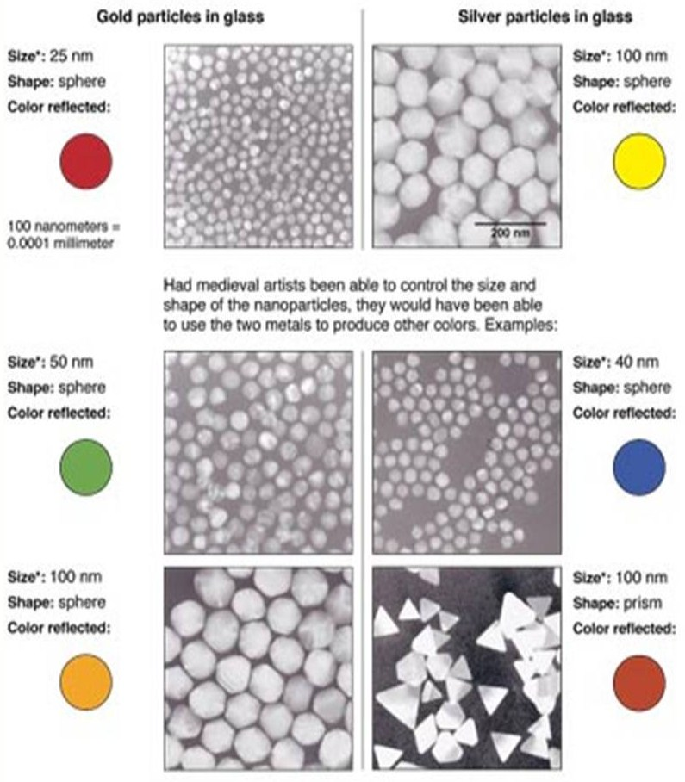
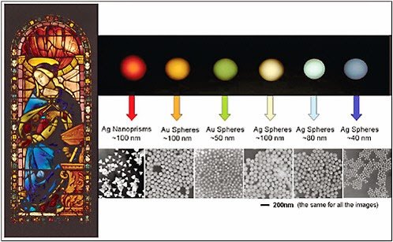
Nanoparticles and color
Gold and Silver
Medical Physics Dept. , 2nd stage, 1st semester, 2018-2019

Slide 5
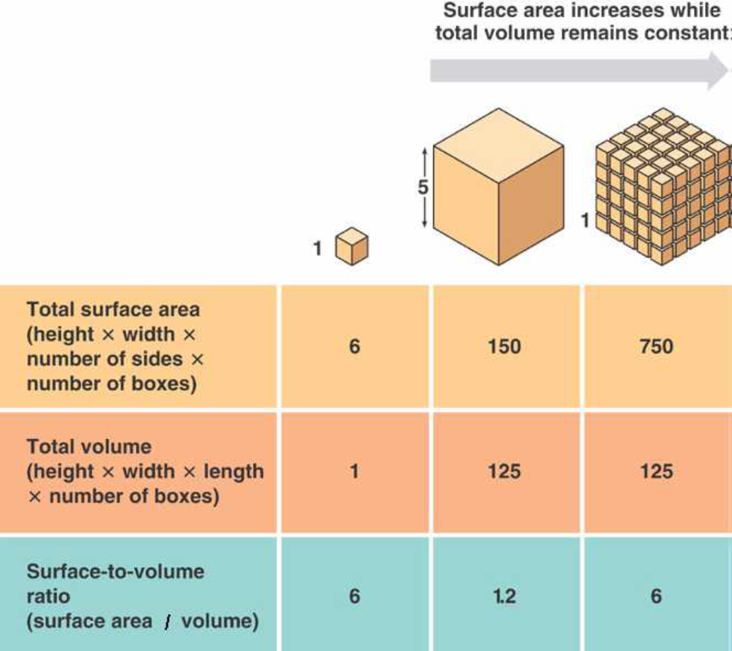
surface to volume ratio
Au: AAA
Atomic mass: 196.967
Density 19.31 gm/cm³
Radii 0.144 nm
Number of Au atoms in 1 m 3.4 X10⁹
Volume of Au atom 4.19 X10²⁸
Surface area Au atom 7.22 X10¹⁹
Surface/volume ratio 1.72 X10⁻⁹
Medical Physics Dept. , 2nd stage, 1st semester, 2018-2019

Slide 6
Nanomaterials: Structural properties
Crystallite size
The crystallite size commonly determined by XRD. Grain is either a single crystalline or polycrystalline material, and is present either in bulk or thin film form. During the processing, smaller crystallites come closer and grow to become larger due to kinetics.
Full width at half maximum
Full width at half maximum (FWHM) is an expression of the extent of function given by the difference between the two extreme values of the independent variable at which the dependent variable is equal to half of its maximum value.
FWHM can be determined as the distance between the curve points at the peak half maximum level. On a data graph, draw a vertical line from the peak maximum to the baseline. Measure the length of this line and divide it by 2 to find the center of the line.
Medical Physics Dept. , 2nd stage, 1st semester, 2018-2019

Slide 7
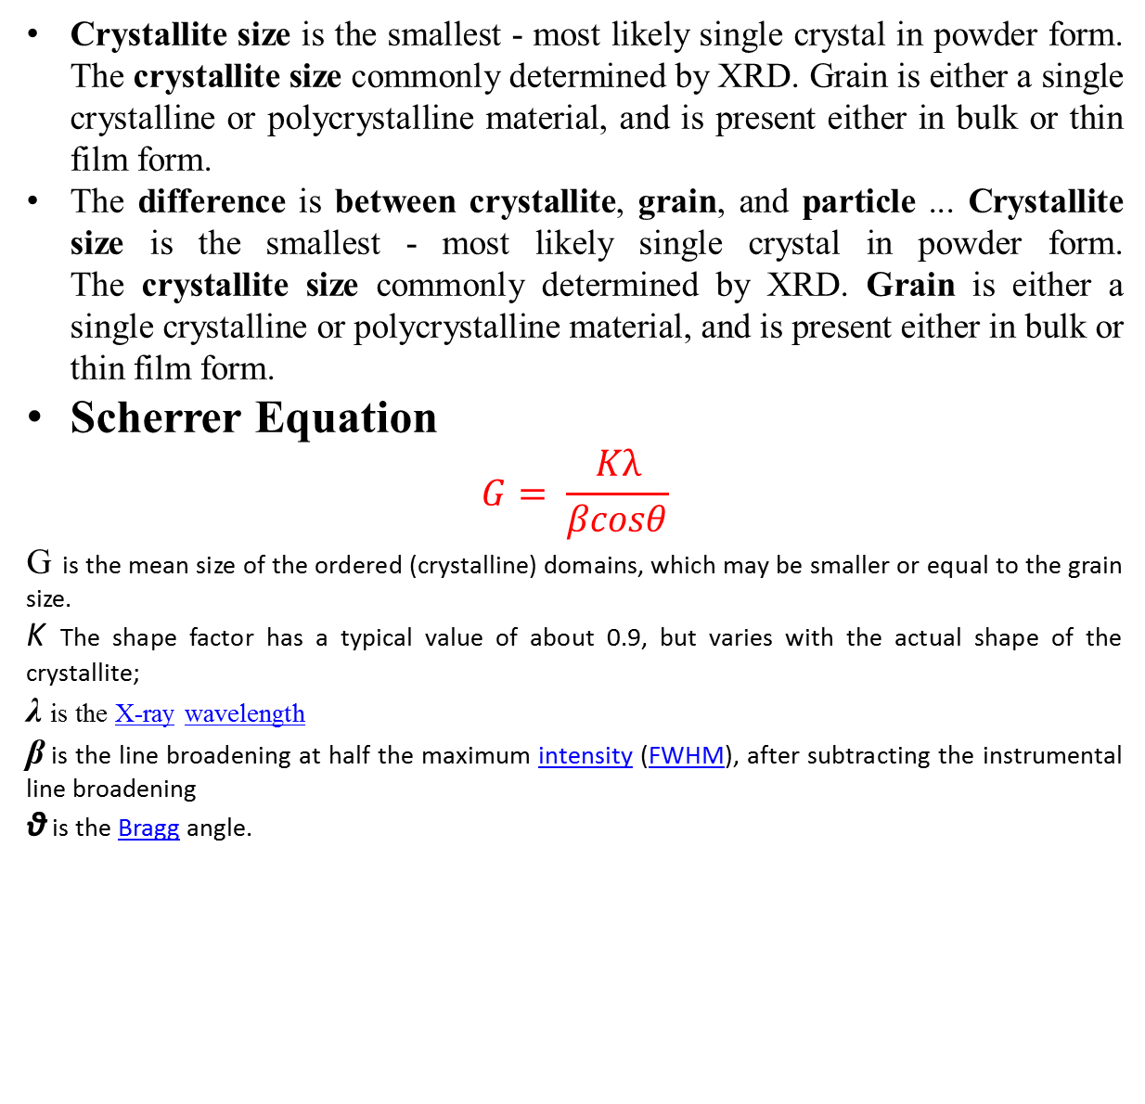
Nanomaterials
Crystallite size is the smallest - most likely single crystal in powder form. The crystallite size commonly determined by XRD. Grain is either a single crystalline or polycrystalline material, and is present either in bulk or thin film form.
The difference is between crystallite, grain, and particle ... Crystallite size is the smallest - most likely single crystal in powder form. The crystallite size commonly determined by XRD. Grain is either a single crystalline or polycrystalline material, and is present either in bulk or thin film form.
Scherrer Equation
$$G= \frac{Kλ}{βcosθ}$$
G is the mean size of the ordered (crystalline) domains, which may be smaller or equal to the grain size.
K The shape factor has a typical value of about 0.9, but varies with the actual shape of the crystallite;
λ is the X-ray wavelength
β is the line broadening at half the maximum intensity (FWHM), after subtracting the instrumental line broadening
θ is the Bragg angle.
Medical Physics Dept. , 2nd stage, 1st semester, 2018-2019

Slide 8
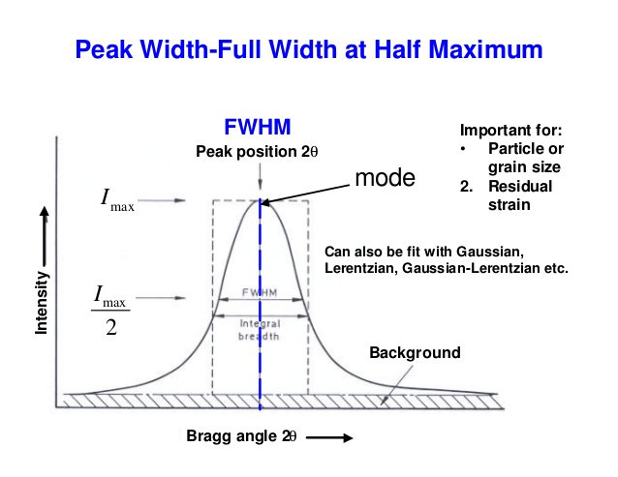
Nanomaterials
Medical Physics Dept. , 2nd stage, 1st semester, 2018-2019

Slide 9

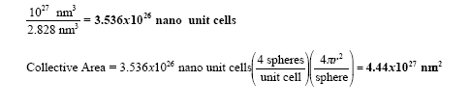


Nanomaterials
Packing Fraction
Medical Physics Dept. , 2nd stage, 1st semester, 2018-2019

Slide 10
Unit cell
Medical Physics Dept. , 2nd stage, 1st semester, 2018-2019

Slide 11
Medical Physics Dept. , 2nd stage, 1st semester, 2018-2019

